Slide 1
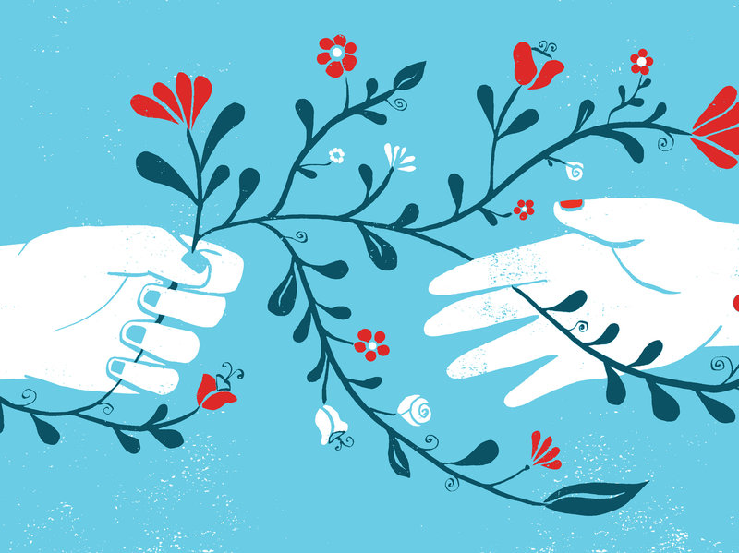
Compassion Focused Behaviour
Support
Dr Brian McClean
Principal Clinical Psychologist
Acquired Brain Injury Ireland

Slide 2


Slide 3
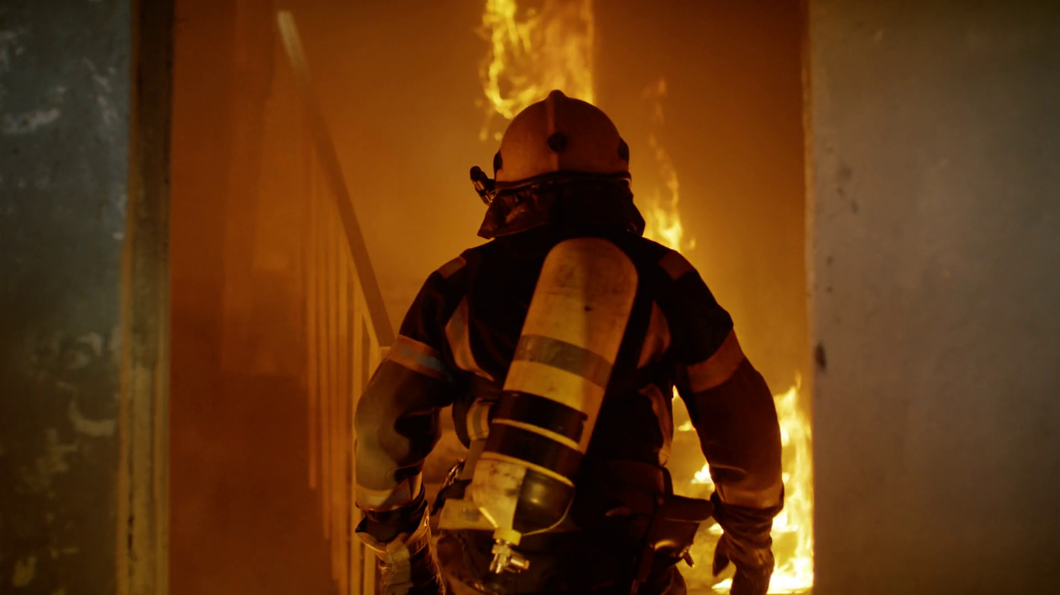

Slide 4
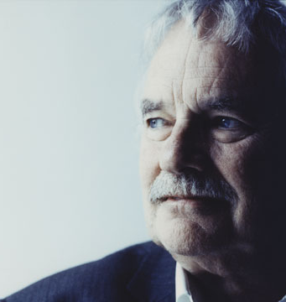
What is compassion?
A sensitivity to the suffering of self and others a deep commitment to try and relieve and prevent it
Paul Gilbert

Slide 5

Sean
9 years old
Severe anxiety &ASD
Older sister with Cystic Fibrosis and ID
Sister very ill when young, nearly died
Terrified something will happen his sister
Too anxious to go to school
Head will explode with 2 billion worries
Threatening to kill himself
Plays with Nintendo until he falls asleep

Slide 6
The Five Term Contingency
Relationships Family
Access to satisfying activities
Life choices Dignity and Respect
Setting Events
_{e.g. Noise}
_{Crowds}
_{Activities}
_{Choice}
_{Predictability}
_{Attention}
_{Hunger}
_{Pain}
_{Diet}
_{Tiredness}
_{Medication}
S_{D}
Behaviour₁
Consequence
Behaviour₂
Differential
Reinforcement
Prompt
Behaviour₃
Immediacy, Value and Probability of Reinforcement
Physical and Cognitive Effort

Slide 7
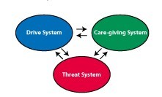
The Five Term Contingency
Relationships Family
Access to satisfying activities
Life choices Dignity and Respect
Setting Events
_{e.g. Noise}
_{Crowds}
_{Activities}
_{Choice}
_{Predictability}
_{Attention}
_{Hunger}
_{Pain}
S_{D}
Behaviour₁
Consequence
Behaviour₂
Differential
Reinforcement
Prompt
Behaviour₃
Immediacy, Value and Probability of Reinforcement
Physical and Cognitive Effort

Slide 8

I think I’m putting on a little weight
Man, I can’t believe I dropped that frisbee in the park
What if the girls won’t like me tomorrow

Slide 9
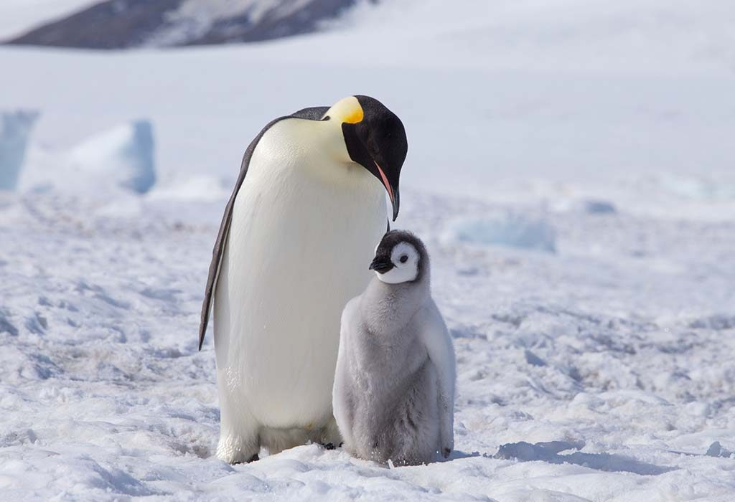

Slide 10
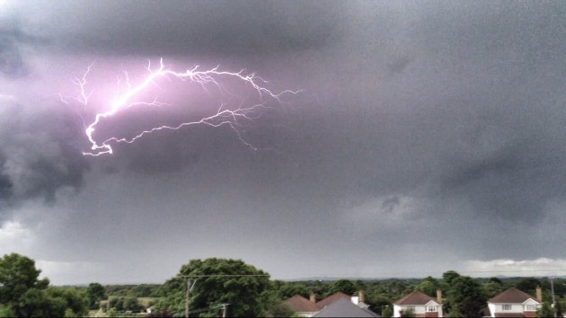

Mum, are we all going to die?
My God! This is terrible! Stop crying. Quick, we have to hide.

Slide 11
Mum, are we all going to die?
Quiet, I’m trying to talk to someone. Don’t interrupt.

Slide 12
Mum, are we all going to die?
Don’t worry, you’re safe with me. It does sound scary doesn’t it. Let’s have a cuddle until the storm passes.

Slide 13
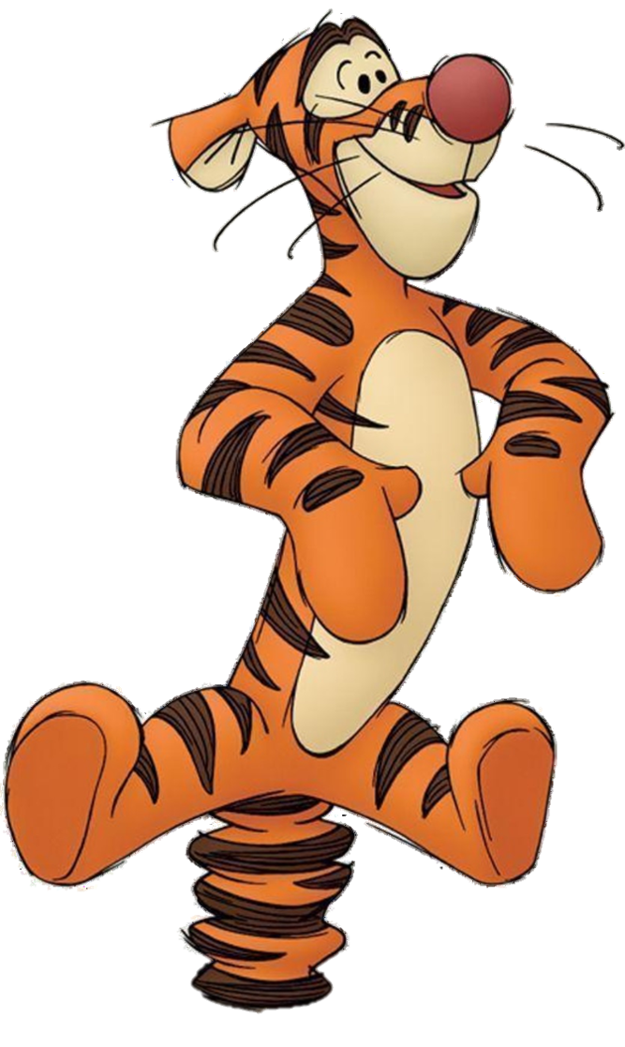
Brendan
15 years of age
Very active, short attention span
Three signs for requesting (sweet, drink, food)
Pre-occupied with food access
Regurgitating, projectile vomiting
Slapping, hair-pulling every hour
Hand biting, face slapping many times per hour
Expelled from school

Slide 14
Five Steps in Behaviour Support
Low arousal
Rapport
Predictability & engagement
Communication
Reward

Slide 15
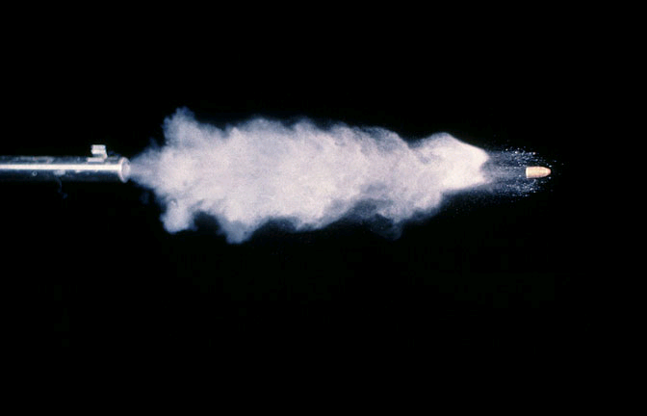
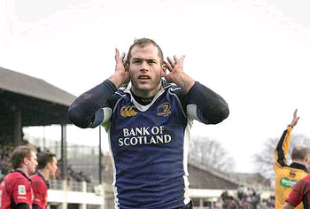
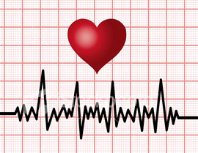
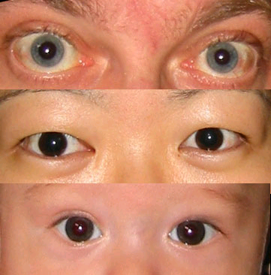
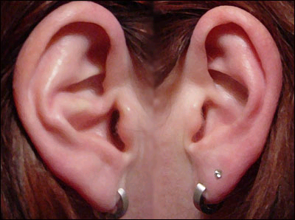
1.Arousal
Fi*!??sh

Slide 16
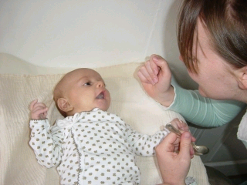
2. Rapport
Follow
Name
Wait
Reinforce

Slide 17
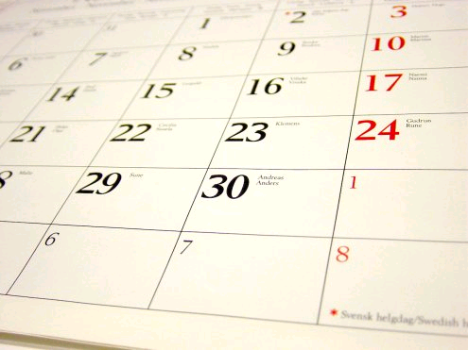

3. Predictability & engagement
Activity preferences
Rituals and Routines
Cues
Choice

Slide 18
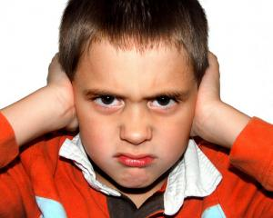
4. Alternative Communication

Slide 19
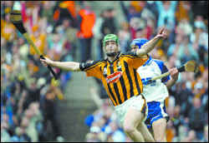
5. Incentive
Come on Declan!

Slide 20
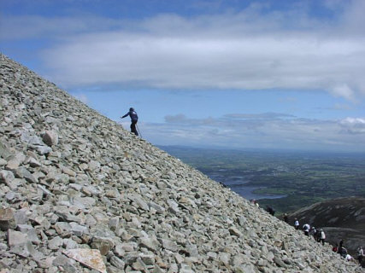
No aggressive behaviour many years
Regularly spontaneously requesting with signs
Participating in food preparation
Visiting community
Climbed Croagh Patrick
Still living and deeply connected with his family

Slide 21
FIVE STEPS IN BEHAVIOUR SUPPORT
Low Arousal
Rapport Building
Predictability
Communication
Incentives
A
B
B
+C
B
+C
+D
B
+C
+D
+E
B
+C
+D
+E
+F
A = Baseline
B = Low Arousal
C = Rapport Building
D = Visual Sequencing
E = Escape Communication Training
F = Differential Reinforcement
Aidan
An Evaluation of an Intervention Sequence Outline in Positive Behaviour Support for People with Autism and Severe Escape-Motivated Challenging Behaviour
McClean, B. and Grey, I., 2012 Journal of Intellectual and Developmental Disabilities 37, 209-20
Brendan
Number of Incidents
Cormac
Darragh
Weeks

Slide 22

Mindfulness is . . .
Paying attention
On purpose
Without judgment
In the present moment
Notes:
Mind-fullness. Fullness of mind includes a whole body experience, not just thinking.
The normal mind is cluttered with distractions, thoughts, fantasies and worries, leaving little room for intention, attention, non-judgment and the present moment.

Slide 23
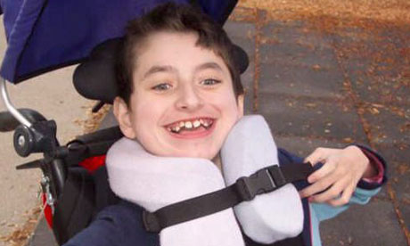
Mindful caregiving increases happiness among individuals with profound multiple disabilities – Singh et al 2004

Slide 24
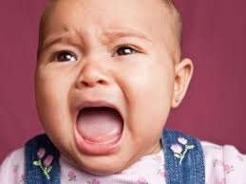

Slide 25
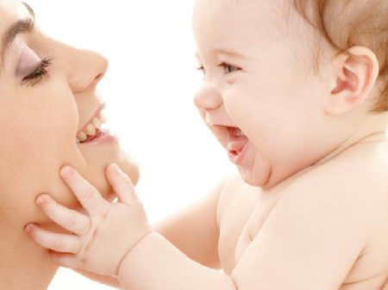

Slide 26


Slide 27
Compassion Focused Model
Drive, excite, vitality
Content, safe, connected
Non-wanting/
Affiliative focused
Safeness-kindness
Soothing
Incentive/resource- focused
Wanting, pursuing, achieving, consuming
Activating
Threat-focused
Protection and
Safety-seeking
Activating/inhibiting
Anger, anxiety

Slide 28
Compassion Focused Behaviour Support
Drive, excite, vitality
Content, safe, connected
Build
Engagement
Build Rapport
3
2
Anger, anxiety
1
Lower
Arousal

Slide 29
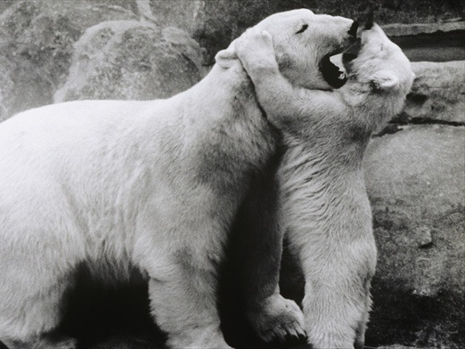

Slide 30
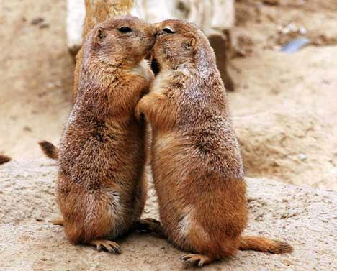

Slide 31
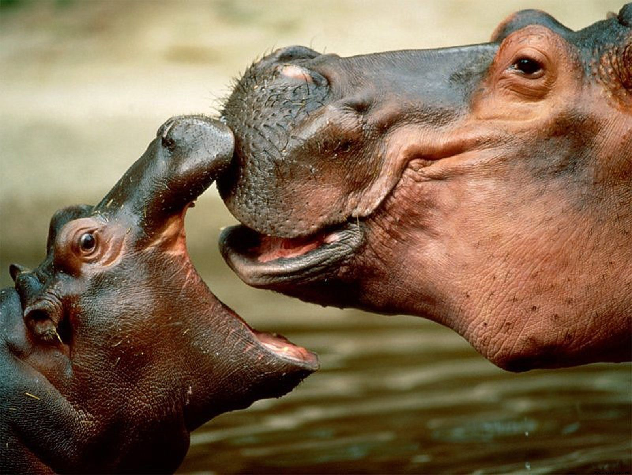

Slide 33
Soothing System
How often is your soothing system triggered
What triggers it?
When activated, how strong is it?
What is the feeling that goes with it (calm, contentment)?
What is the behaviour that goes with it (relaxation, care-giving, care-receiving)?
What is it like in the body?
What happens to thoughts, imagination?

Slide 34
Sean
9 years old
Severe anxiety & ASD
Older sister with Cystic Fibrosis and ID
Sister very ill when young, nearly died
Terrified something will happen his sister
Too anxious to go to school
Head will explode with 2 billion worries
Threatening to kill himself
Plays with Nintendo until he falls asleep

Slide 36


Slide 37
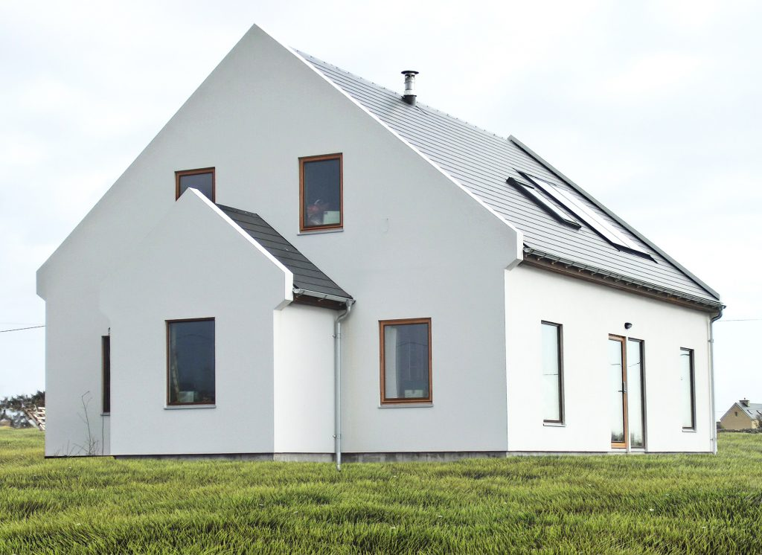

Slide 38
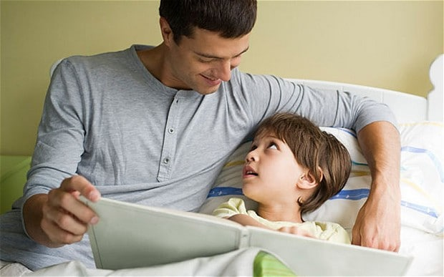

Slide 39


Slide 40
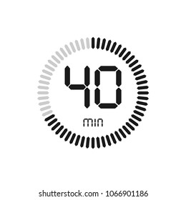


Slide 41
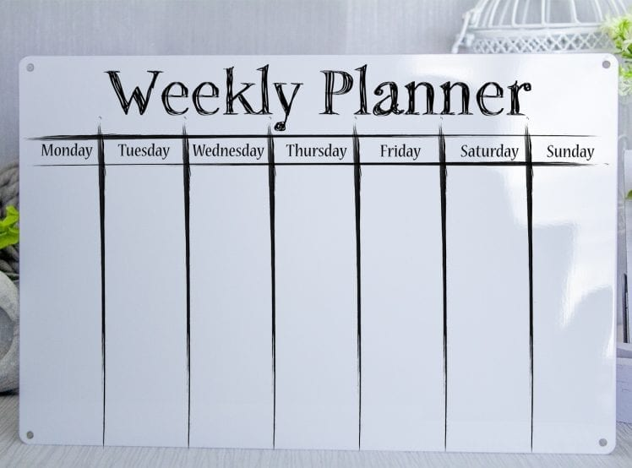

Slide 42
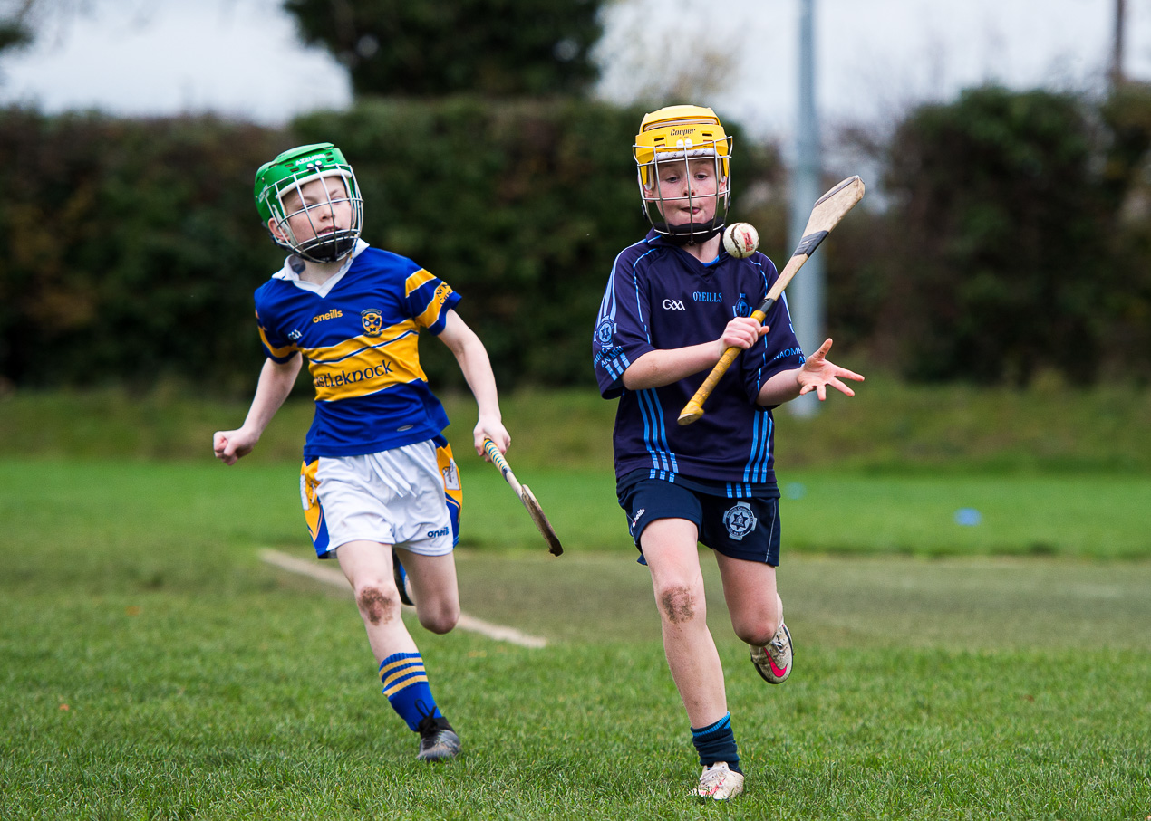

Slide 43
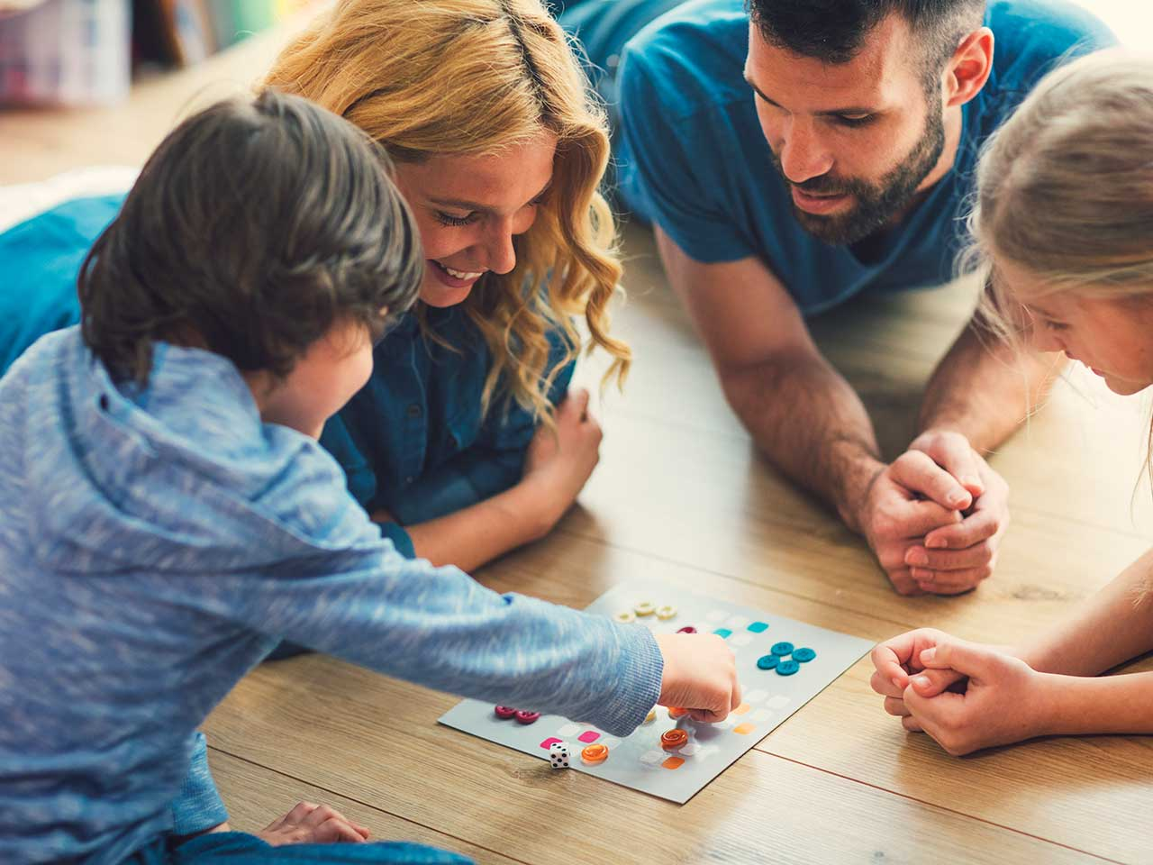

Slide 44


Slide 45
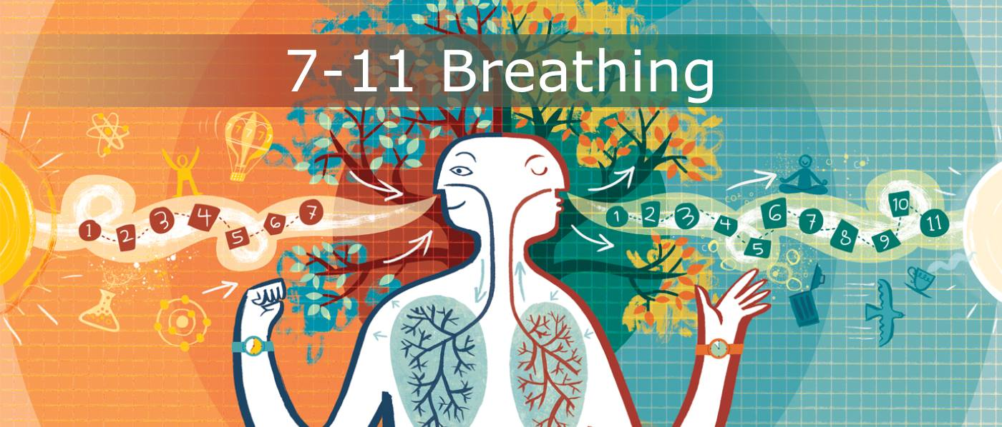

Slide 46


Slide 47
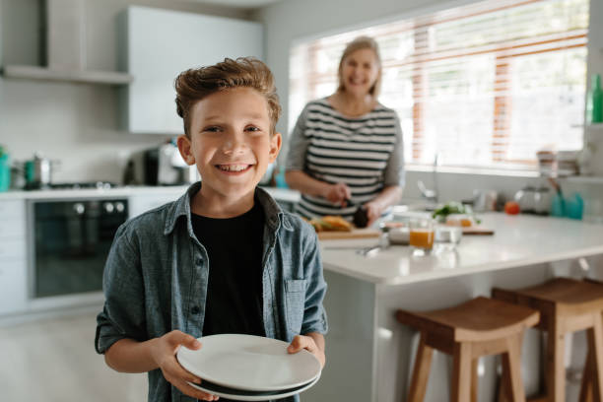

Slide 48
