Slide 1
Compassionate Care: Can it be Taught?
Jeridith Lord, LCPC
PhD Student at Endicott College

Slide 2
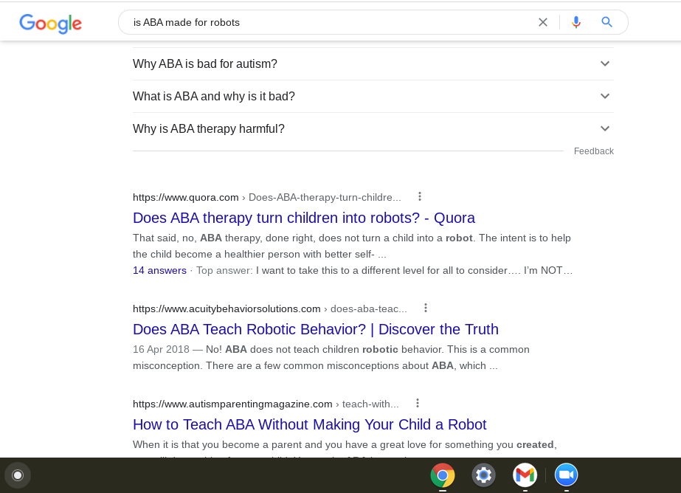

Understanding Compassionate Care: Why is it important?
Notes:
Understanding compassionate care
First of all, why is it important?
We’re kinda robots?
Ok not really - but we are often accused of being robotic. With the rigor and structure that behavior analysis is based on, without formal instruction on compassionate care skills, it is understandable why so many view our instruction as robotic. We, as a field, need to do better.
Defining compassionate care from the perspective of a behavior analyst can be tricky - a lot of the definitions are based in deeply mentalistic terms and saturated with feelings. (make a grossed out sound) As much as the world would like to think that behavior analysts are robots, we aren’t - therefore, I invite you on a journey of suspension of disbelief.
We see more concrete parameters as time progresses

Slide 3
Definitions over the years…
Roach,
2007
Lown,
2014
Merriam-Webster, 2010
Rohrer et al, 2021
Notes:
Definitions over the years - gradual development of the definition. Try and pick out some key words and later, we’ll create our own operational definition
2007: immersion into the pain, brokenness, fear, and anguish of another, even when that person is a stranger (Roach, 2007).
2010: a sympathetic consciousness of others’ distress with a desire to alleviate it; feeling and exhibiting concern and empathy for others (Merriam-Webster, 2010).
2014: the recognition, empathic understanding of and emotional resonance with the concerns, pain, distress or suffering of others coupled with motivation and relational action to ameliorate these conditions (Lown et al 2014)
2021: Empathetic and collaborative processes that promote parental/caregiver involvement, are nondirective, personal, and are likely to lead to continued services, empowered families, and positive experiences with ABA (Rohrer et al, 2021).

Slide 4
Measuring compassionate care
Compassionate Care Assessment Tool (CCAT)
Fogarty’s Compassion Scale (CS)
Schwartz Compassionate Care Scale
CCAT | CS | SCCS
5 items | 5 Items | 12 items
Notes:
Measuring compassionate care - the three scales we’re gonna compare are the compassionate care assessment tool (CCAT), the compassion scale (CS), and the Schwartz compassionate care scale (SCCS)

Slide 5
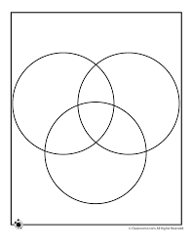
Expressing sensitivity/caring/compassion, Striving to understand emotional needs, Considering the effect of the illness on you/your family/those close to you, Listen attentively, Convey info in a way that it understandable, Gain your trust, Always involve you in decisions about your treatment, Comfortably discuss sensitive/emotional/psychological issues, Treat you as a person rather than a disease, Show respect for you/all those that you love, Communicate results in a timely/sensitive manner, & Spend enough time with you
CCAT
CS
SCCS
Helped control pain, Understood medical issue, Worked competently, Skilled with equipment, & Treated you without judgment
Wants what is best for the patient, Cares about the patient, Acknowledges patient’s emotions, Encourages patient’s questions, & Encourages patient involvement in treatment decision
Notes:
Measuring compassionate care
Compassionate care assessment tool (CCAT) (Burnell & Agan, 2013).
Distributed in clinical settings as part of the outpatient process. Combo of spiritual needs assessment and the caring behaviors inventory
Top 5 ranking questions (by patient agreement of importance)
Helped control pain
Understood medical issue
Worked competently
Skilled with equipment
Treated you without judgment
Questions ranked on a likert scale 1-4
Fogarty’s compassion scale
2 videos: one demonstrated a doctor explaining the treatment process for his patient’s cancer. The 2nd video did the same but added 40 seconds of compassionate phrases: “I know this is a tough experience to go through and I want you to know that I am here with you. Some of the things that I say to you today may be difficult to understand, so I want you to feel comfortable in stopping me if something I say is confusing or doesn’t make sense. We are here together, and we will go through this together”
Spoiler: these extra 40 seconds reduced patient anxiety SIGNIFICANTLY when compared to the control group. Affected decision on whether or not to proceed with the treatment.
5 items atient rated compassionate statements by physician:
Wants what is best for the patient
Cares about the patient
Acknowledges patient’s emotions
Encourages patient’s questions
Encourages patient involvement in treatment decision
12 Item Schwartz compassionate care scale >>> LETS GO
So obviously 12 items
Non hospitalized patients were sampled using an online platform - goal is to gauge compassionate care and gaps in its demonstration
12 items include:
Expressing sensitivity, caring, and compassion
Striving to understand emotional needs
Considering the effect of the illness on you, your family, and those close to you
Listen attentively
Convey info in a way that it understandable
Gain your trust
Always involve you in decisions about your treatment
Comfortably discuss sensitive/emotional/psychological issues
Treat you as a person, not a disease
Show respect for you and all those that you love
Communicate results in a timely and sensitive manner
Spend enough time with you

Slide 6

Attempt 1… How’d it go?

Slide 7

Attempt 2… How’d it go?

Slide 8
What do all of these scales have in common?
The provider eases pain, anxiety, and emotions associated with the treatment. They acknowledge these sensitively and attentively.
The provider understands the issue at hand and explains it in a way that helps the patient understand the issue and their options.
The provider does not judge and encourages the patient to ask questions and be involved in their treatment.
CCAT
CS
SCCS
Notes:
Measuring compassionate care - where’s the overlap?
Reviewing all three of these skills brings me to the conclusion of the truth lying in the unofficial IOA - i.e. the overlap
All three scales emphasize the importance of:
The provider eases pain, anxiety, and emotions associated with the treatment. They acknowledge these sensitively and attentively.
The provider understands the issue at hand and explains it in a way that helps the patient understand the issue and their options.
The provider does not judge and encourages the patient to ask questions and be involved in their treatment.
This, of course, does not discount the importance of the parts of the scales that do not overlap - For example, I think that it's super important for providers to consider the effects on the family.
However, if we break this down as simply as possible, these areas are considered the VIP ratings of compassionate care.

Slide 9
Learning history and compassionate care
Learning history plays a huge role in the development of compassion.
Starts when we’re young and develops the same way that any of those emotional dispositions develop.
Think of this from the perspective of relational frames: if you were taught to look at yourself with compassion, you’re more likely to be able to view others with compassion
Notes:
Just read the slide

Slide 10
Operationally-ish defining compassionate care
Immersion into another person to understand and reduce their distress from an empathetic or concerned perspective with the intent to promote collaborative, nondirective, and empowering support.
Lown et al 2014: the recognition, empathic understanding of and emotional resonance with the concerns, pain, distress or suffering of others coupled with motivation and relational action to ameliorate these conditions
Rohrer et al 2021: Empathetic and collaborative processes that promote parental/caregiver involvement, are nondirective, personal, and are likely to lead to continued services, empowered families, and positive experiences with ABA
Roach in 2007: immersion into the pain, brokenness, fear, and anguish of another, even when that person is a stranger
dictionary definition in 2010: a sympathetic consciousness of others’ distress with a desire to alleviate it; feeling and exhibiting concern and empathy for others
Notes:
Operationally defining compassion
Remembering those key definitions from earlier
Roach in 2007: immersion into the pain, brokenness, fear, and anguish of another, even when that person is a stranger (Roach, 2007).
Good old fashion dictionary definition in 2010: a sympathetic consciousness of others’ distress with a desire to alleviate it; feeling and exhibiting concern and empathy for others (Merriam-Webster, 2010).
Lown et al 2014: the recognition, empathic understanding of and emotional resonance with the concerns, pain, distress or suffering of others coupled with motivation and relational action to ameliorate these conditions (Lown et al 2014)
Rohrer et al 2021: Empathetic and collaborative processes that promote parental/caregiver involvement, are nondirective, personal, and are likely to lead to continued services, empowered families, and positive experiences with ABA (Rohrer et al, 2021).
Compassionate care operationally defined
Immersion into another person to understand and reduce their distress from an empathetic or concerned perspective with the intent to promote collaborative, nondirective, and empowering support.

Slide 11
Bringing it back to behaviorism: Defining and Measuring
Immersion into another person to understand and reduce their distress from an empathetic or concerned perspective with the intent to promote collaborative, nondirective, and empowering support.
The provider eases pain, anxiety, and emotions associated with the treatment. They acknowledge these sensitively and attentively.
The provider understands the issue at hand and explains it in a way that helps the patient understand the issue and their options.
The provider does not judge and encourages the patient to ask questions and be involved in their treatment.
Notes:
This is the definition we’ve come up with. These are the areas represented across all scales. They add up.

Slide 12
…but can it be taught?
The barrier isn’t teaching care, but rather teaching compassion
  If it’s a behavior, we can teach it
Assuming that someone has naturally developed compassion, then I am optimistic that we can teach compassionate care.
  Compassion education interventions must be: empirically based, competency-based, employ multimodal teaching methods, & evaluative (Sinclair et al, 2021)
Barriers to consider
Difficult to define compassion
Limited to self report and often no control group
Cannot be replicated clinically
Notes:
Read the slide

Slide 13
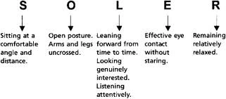

Expectations in delivery
CCAT
CS
SCCS

Slide 14
Looking towards the future (summary)
Understanding compassionate care
Defining compassionate care
Measuring compassionate care
Teaching compassionate care
Compassionate care in behavior analysis is of critical importance: not just for us, not just for our clients, but for everyone that comes after us. This field will only grow through this connection to those we serve.
Notes:
Looking towards the future (summary)
Understanding compassionate care
It’s IMPORTANT. Not just for us, but for everyone who comes after us.
Defining compassionate care from the perspective of a behavior analyst can be tricky - but maybe that’s ok for now. More concrete terms will develop over time - we’ve already seen that progression from 2007 > 2010 > 2014 > 2021.
Compassionate care operationally defined
Immersion into another person to understand and reduce their distress from an empathetic or concerned perspective with the intent to promote collaborative, nondirective, and empowering support.
Measuring compassionate care is as important as defining us. We examined three scales: compassionate care assessment tool (CCAT), the compassion scale (CS), and the Schwartz compassionate care scale (SCCS)
VIP overlap
All three scales emphasize the importance of:
The provider eases pain, anxiety, and emotions associated with the treatment. They acknowledge these sensitively and attentively.
The provider understands the issue at hand and explains it in a way that helps the patient understand the issue and their options.
The provider does not judge and encourages the patient to ask questions and be involved in their treatment.
We concluded that if someone has compassion, then they can be taught compassionate care.
If it's a behavior, we can teach it.
BST for compassionate care follows the same model as anything else using BST: Instruction, modeling, rehearsal, feedback

Slide 15
References
Burnell, L., & Agan, D. L. (2013). Compassionate care: Can it be defined and measured? The development of the Compassionate Care
Assessment Tool. International Journal of Caring Sciences, 6(2), 180-187.
Fogarty, L. A., Curbow, B. A., Wingard, J. R., McDonnell, K., & Somerfield, M. R. (1999). Can 40 seconds of compassion reduce patient
anxiety?. Journal of Clinical Oncology, 17(1), 371-371.
Lown, B. A., McIntosh, S., McGuinn, K., Aschenbrener, C., DeWitt, B. B., Chou, C., et al. (2014). Triple C conference framework
tables. Retrieved from http://www.theschwartzcenter.org/media/Triple-CConference-Framework-Tables_FINAL.pdf
Luoma, J. B., & Platt, M. G. (2015). Shame, self-criticism, self-stigma, and compassion in acceptance and commitment therapy. Current
opinion in Psychology, 2, 97-101.
Merriam-Webster's collegiate dictionary (2010). Springfield, MA: Merriam-Webster.
Roach, M. S. (2007). Caring, the human mode of being. Ottawa, Ontario: CHC Presses de l’ACS
Rohrer, J. L., Marshall, K. B., Suzio, C., & Weiss, M. J. (2021). Soft Skills: The Case for Compassionate Approaches or How Behavior
Analysis Keeps Finding Its Heart. Behavior Analysis in Practice, 1-9.
Sinclair, S., Kondejewski, J., Jaggi, P., Dennett, L., Roze des Ordons, A. L., & Hack, T. F. (2021). What Is the State of Compassion
Education? A Systematic Review of Compassion Training in Health Care. Academic medicine : journal of the Association of
American Medical Colleges, 96(7), 1057–1070. https://doi.org/10.1097/ACM.0000000000004114

